Slide 1

Turning glass windows into solar panels

Slide 2
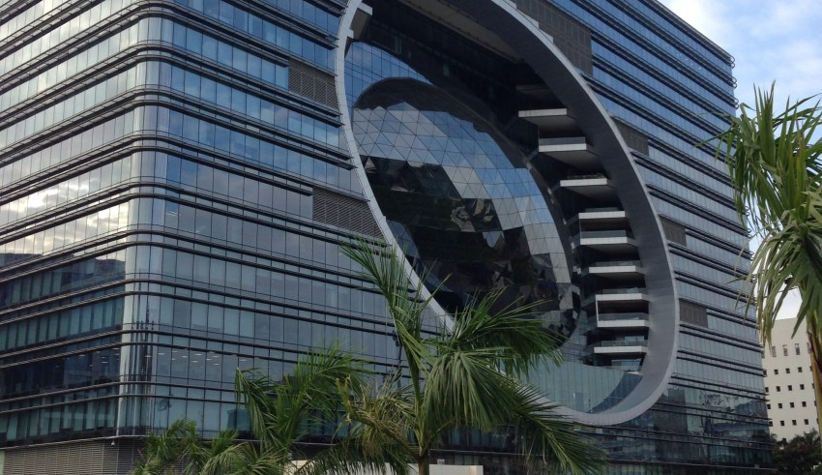

So, why do most of the high rise buildings and skyscrapers use glass window panes?
The answer is simple. Glass window panes are transparent and hence no one has to sit in darkness as an ample amount of light enters through the windows inside the building.
But we cannot deny that along with light, heat also enters through the glass window panes.

Slide 3
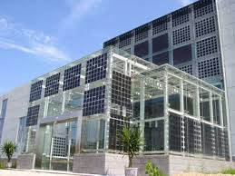
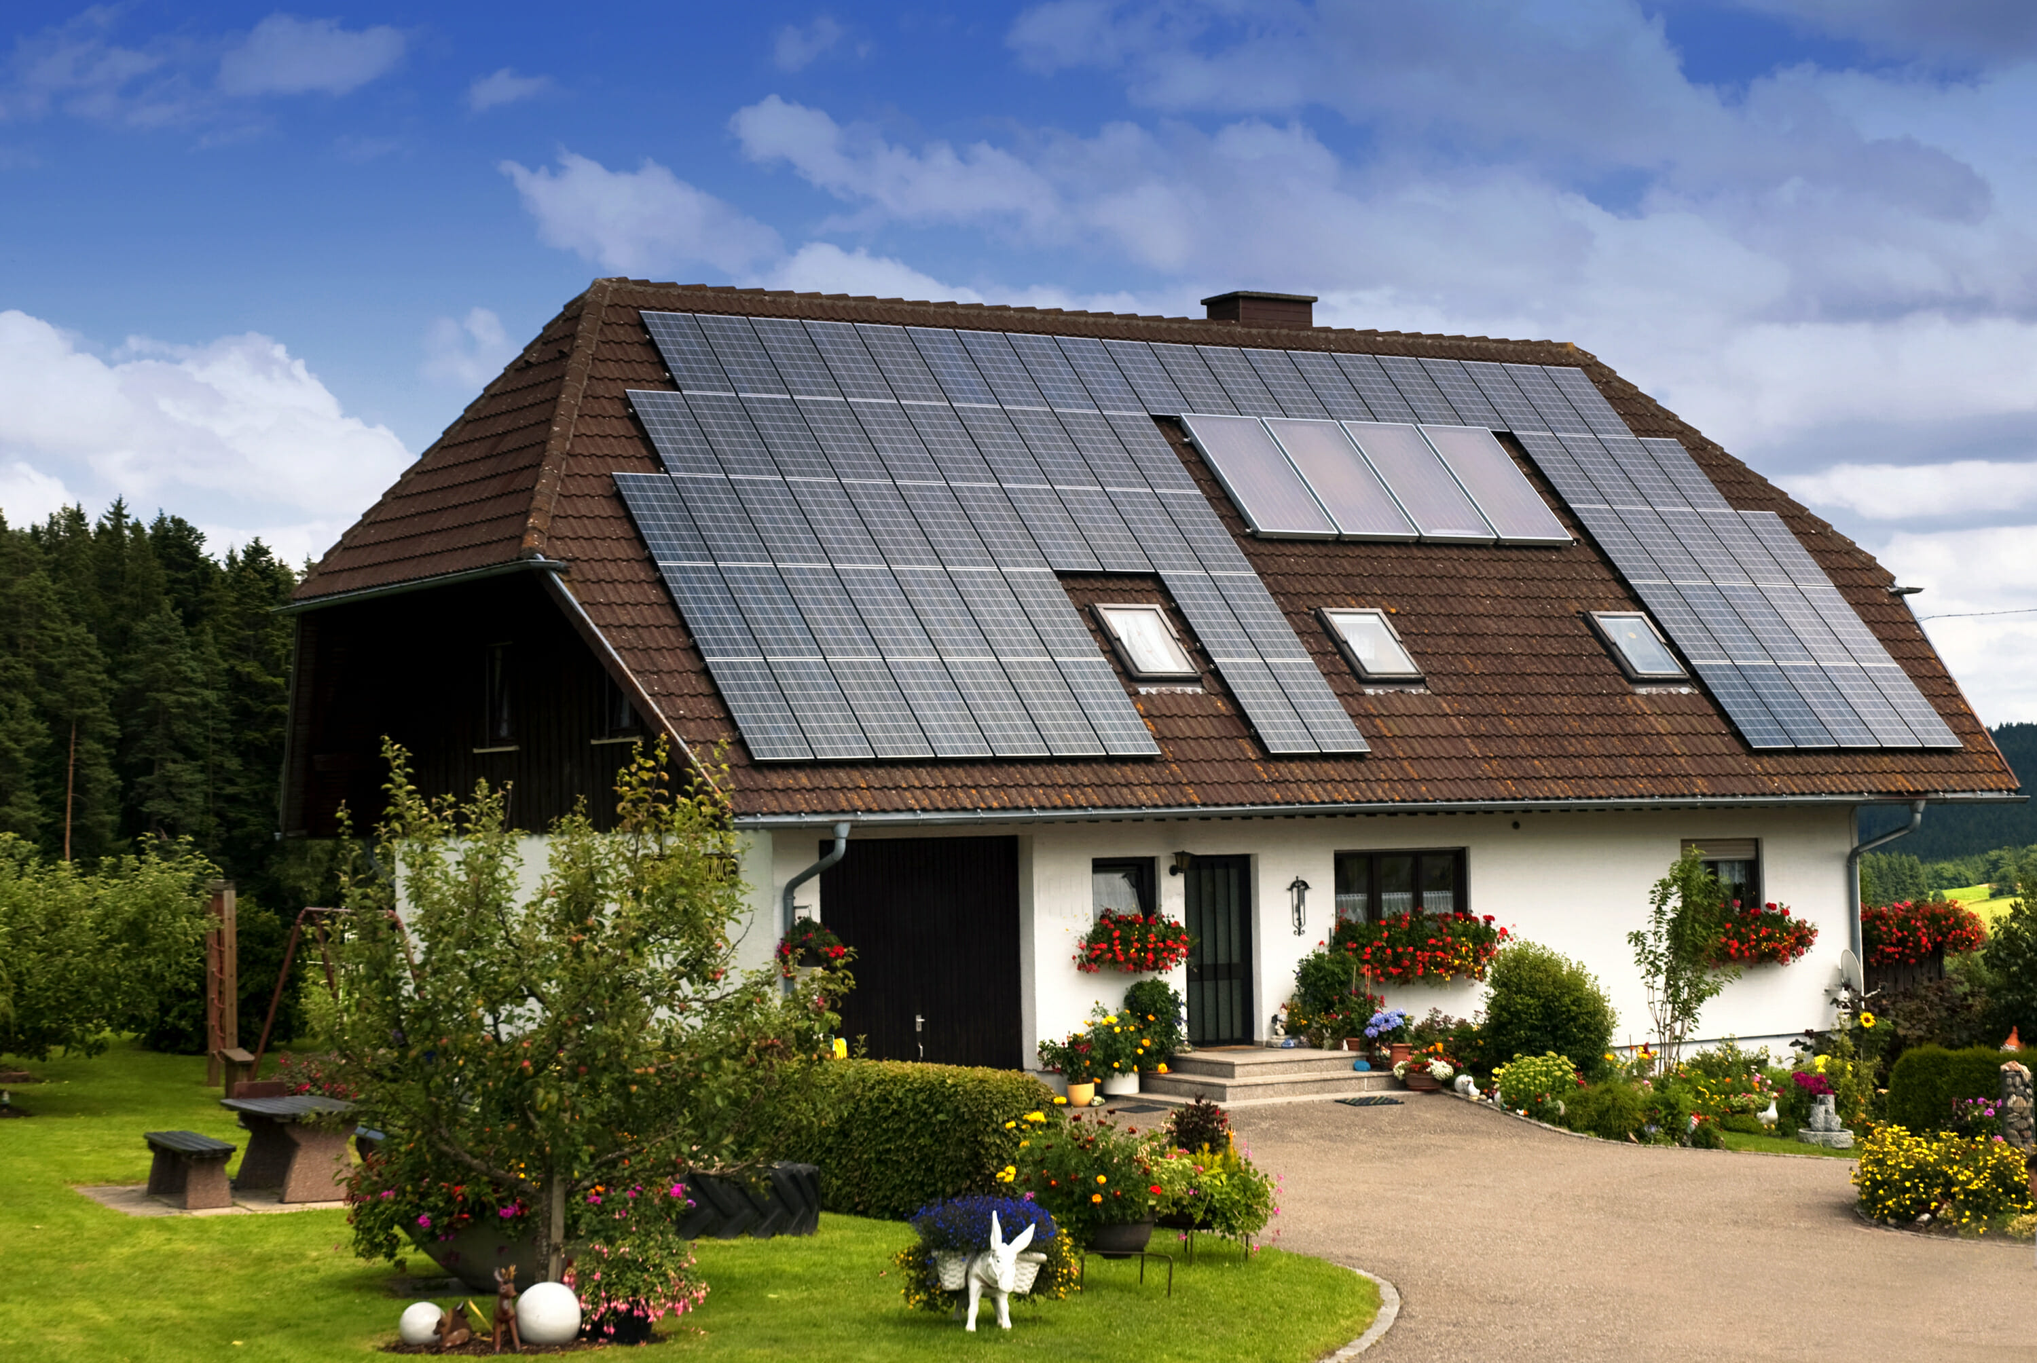
Imagine if every building and skyscraper in India had solar power windows that could generate a small amount of electricity from the sun.
And why only high rise buildings and skyscrapers?
We can also use solar panels on the roof top of our houses.

Slide 4

Solar Energy is a source of clean, renewable source of energy which is also non polluting at the same time. So why not make the best use of it?
So in case of buildings how can the electricity generated through solar panels be utilized?
Solar window frames can be connected to a central power inverter which can convert the direct current from the solar window to alternating current. This alternating current can be fed into the electric panel for the building.
Also, 83% of energy can be saved by switching from glass windows to solar windows.
83% a great figure right!

Slide 5
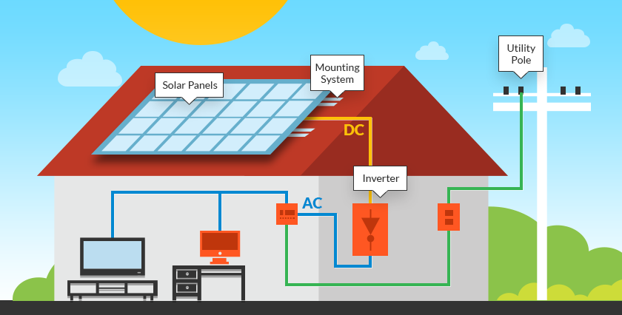
If the residents of apartments and small bungalows take proper initiative of adding solar panels on the roof tops, they will be switching to a complete renewable source of energy.
So in case of load shedding (one of the major issues of metropolitan cities), this stored solar energy can be utilized to its fullest to illuminate the apartment.

Slide 6
This is the best phenomenal solution which can be used as an innovation for business as well as society.
As one can switch from glass window panes and use solar panels the solar energy generated from the solar panels would be the best possible alternative for the existing polluting, non-renewable sources of energy.

Slide 7
Thank you

